Slide 1
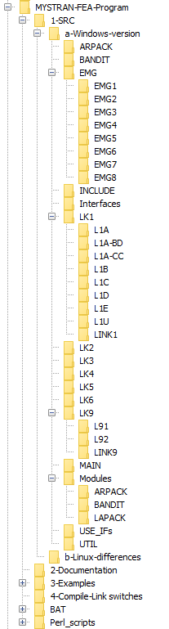
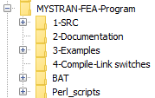
Figure 1 MYSTRAN FEA program file structure
Fig 1-b
Expanded view
Fig 1-a
Overall view

